Slide 1


Titolo presentazione sottotitolo
Smart Dryer
Milano, XX mese 20XX
Matteo Baschieri
Valentina Grieci

Slide 2
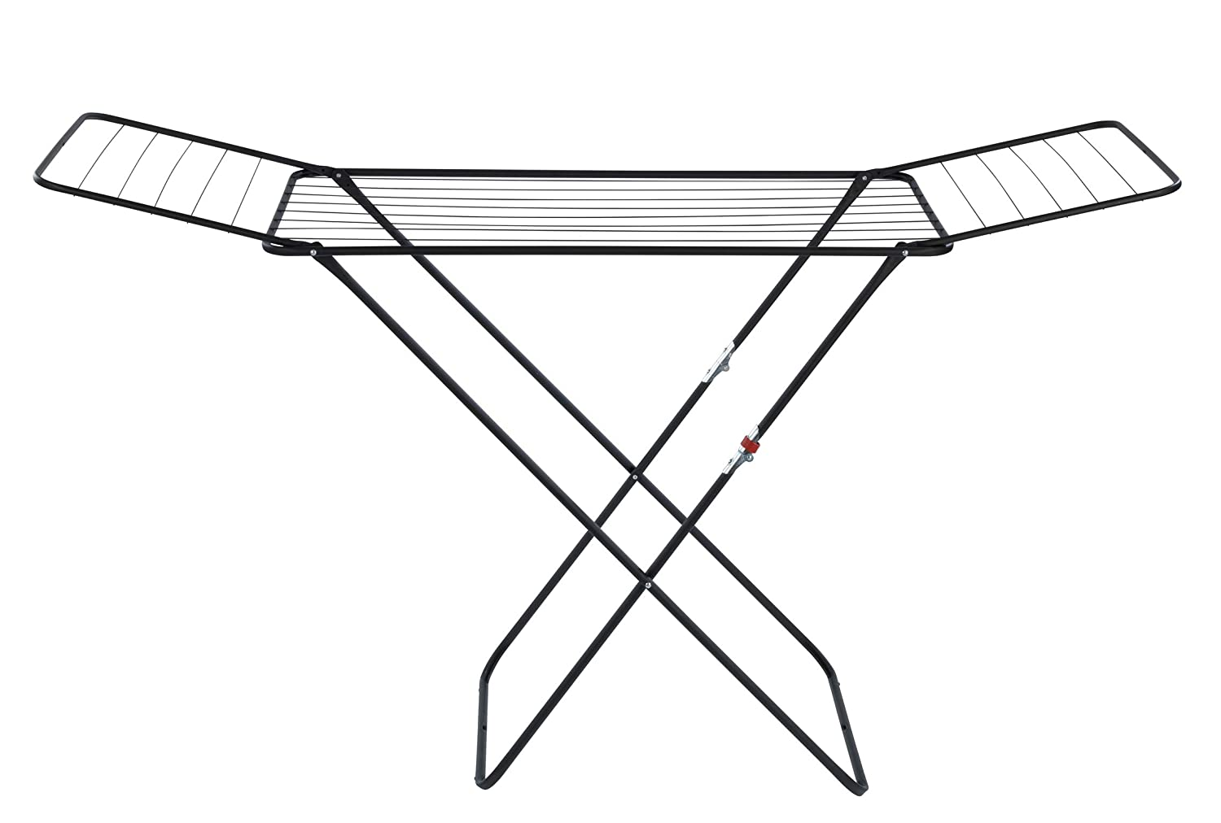
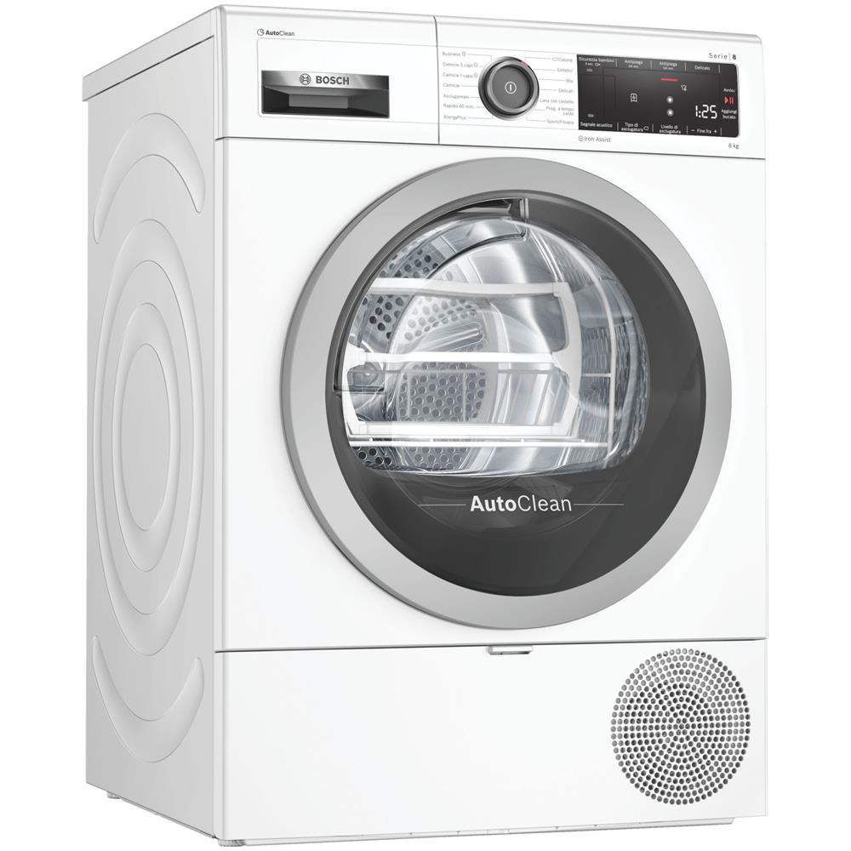
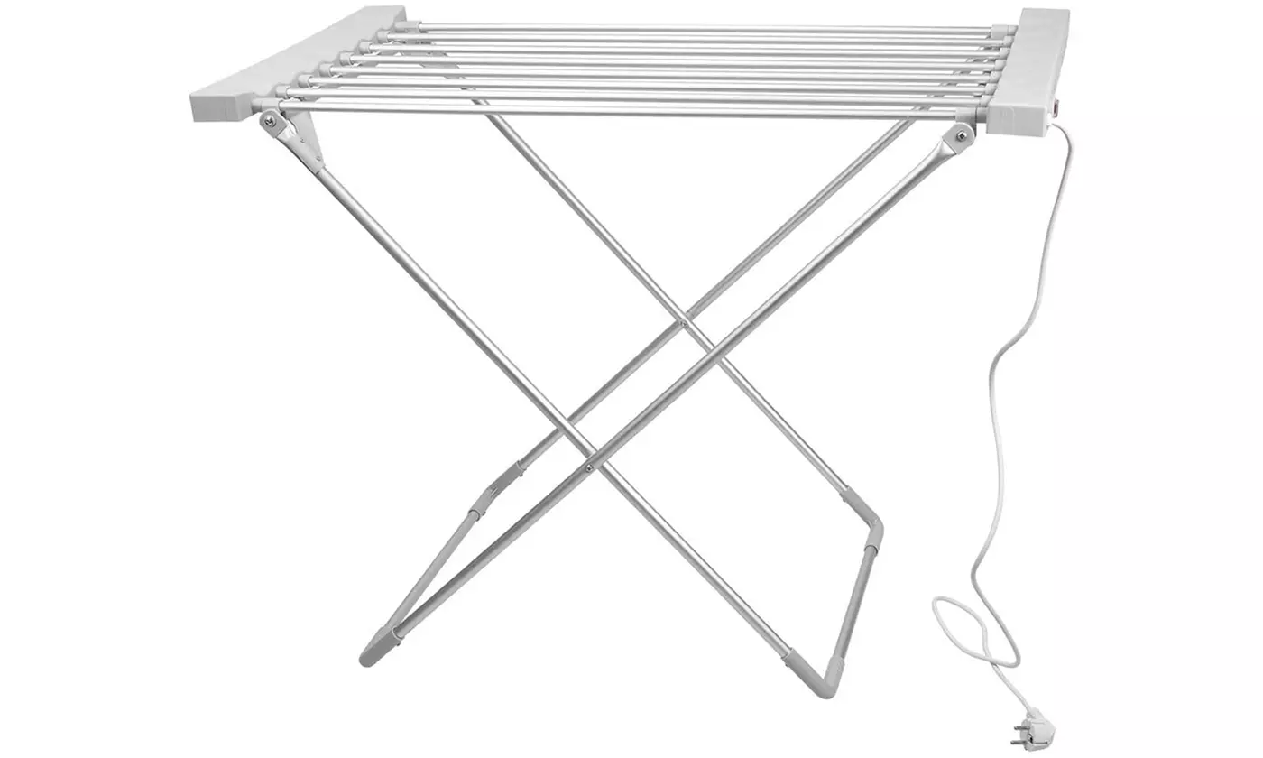
Introduction
Drying Rack
Dryer
Electric drying rack
Washing and drying clothes is a necessary everyday activity.
There are already several devices designed to solve the problem of drying clothes.
Our study aims to create a low-cost smart system to optimize this process.

Slide 3
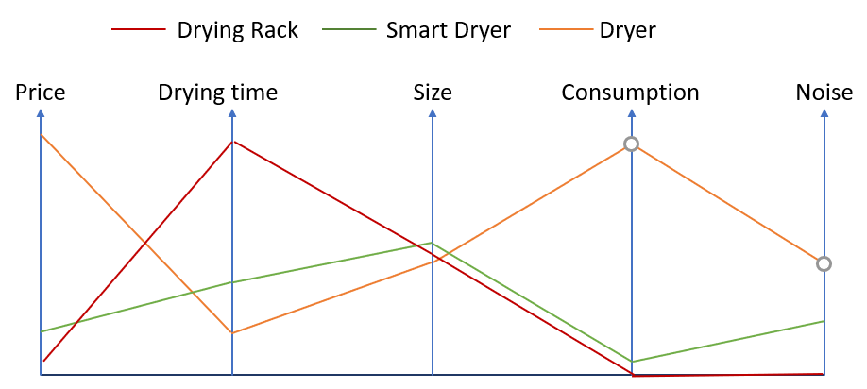
Poll and Market Analysis
 | Not much | Quite enough | A lot
How much is important that the clothes dry fast? | 16,5% | 47,1% | 36,5%
How much is important that a drying system has little dimensions? | 11,8% | 60% | 29,4%
How much is important that drying system is quiet? | 3,5% | 35,3 | 61,2%
Considering a drying system would you choose: | (1) | (2)
Fast but expensive Slow but cheap | 23,5 % | 76,5%
Fast but with high consumption Slow but with low consumption | 9% | 89,4%
Comparison of the main characteristics of the drying systems

Slide 4
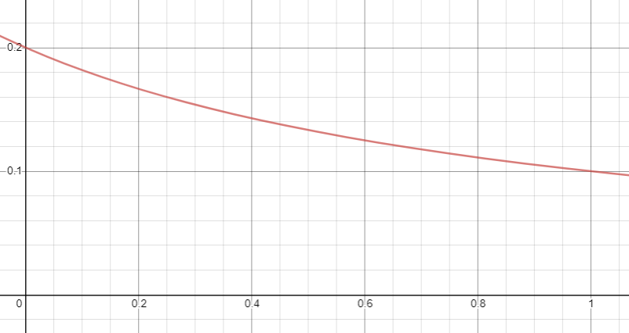
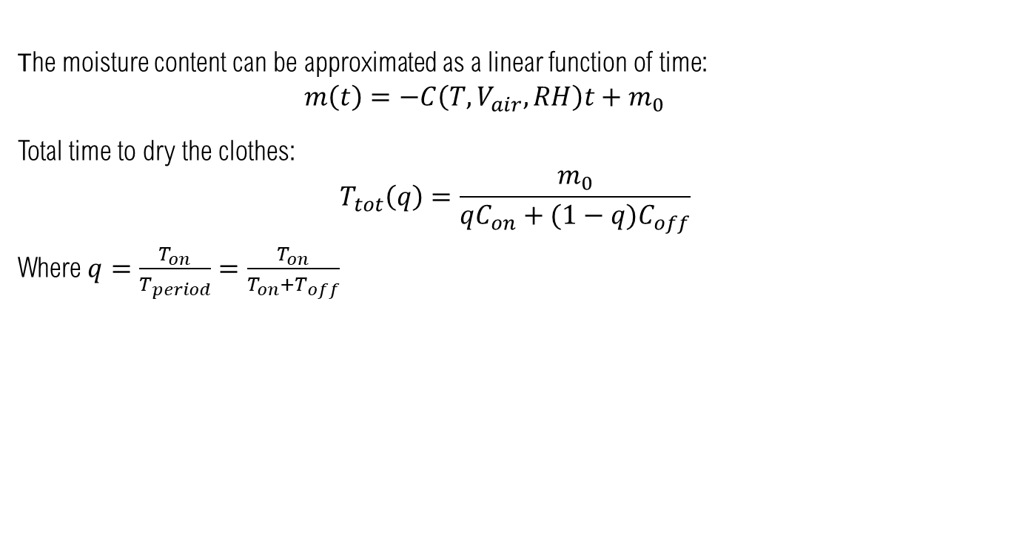
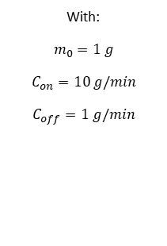
System Description
The moisture content can be approximated as a linear function of time:
$$m\left(t\right)=−C\left(T, V_{air},RH\right)t+m_{0}$$
Total time to dry the clothes:
$$T_{tot}\left(q\right)=\frac{m_{0}}{qC_{on}+(1−q)C_{off}}$$
Where $q=\frac{T_{on}}{T_{period}}=\frac{T_{on}}{T_{on}+T_{off}}$
T [min]
With:
$$m_{0}=1 g$$
$$C_{on}=10 g/min$$
$$C_{off}=1 g/min$$
q [-]

Slide 5
System Specification and General Architecture
The system must:
make the drying process faster,
understand when the clothes are dry,
notice the user that the clothes are dry.
User interface
Drying component
Sensor I
Microcontroller
Battery
Packaging
Sensor II
Schematic representation of the system

Slide 6
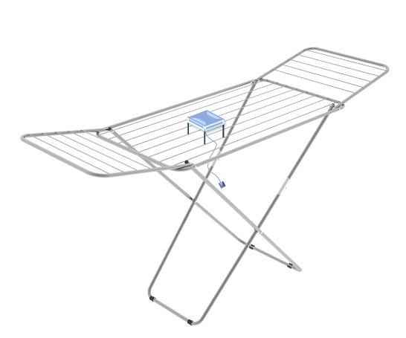
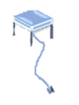
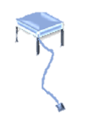
System Characteristics
Customer rack adaptable
Customer preferences adaptable
three modalities:
fast drying: fan always on until the drying is complete;
normal regime: 5 minutes on and 5 off, repeat until the drying is complete;
energy saving: 3 minutes on and 9 off, repeat until the drying is complete.
=module
Possible positioning of the module on different drying rack

Slide 7
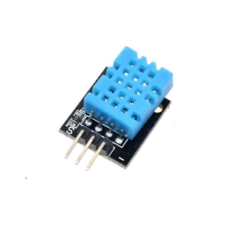
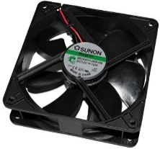
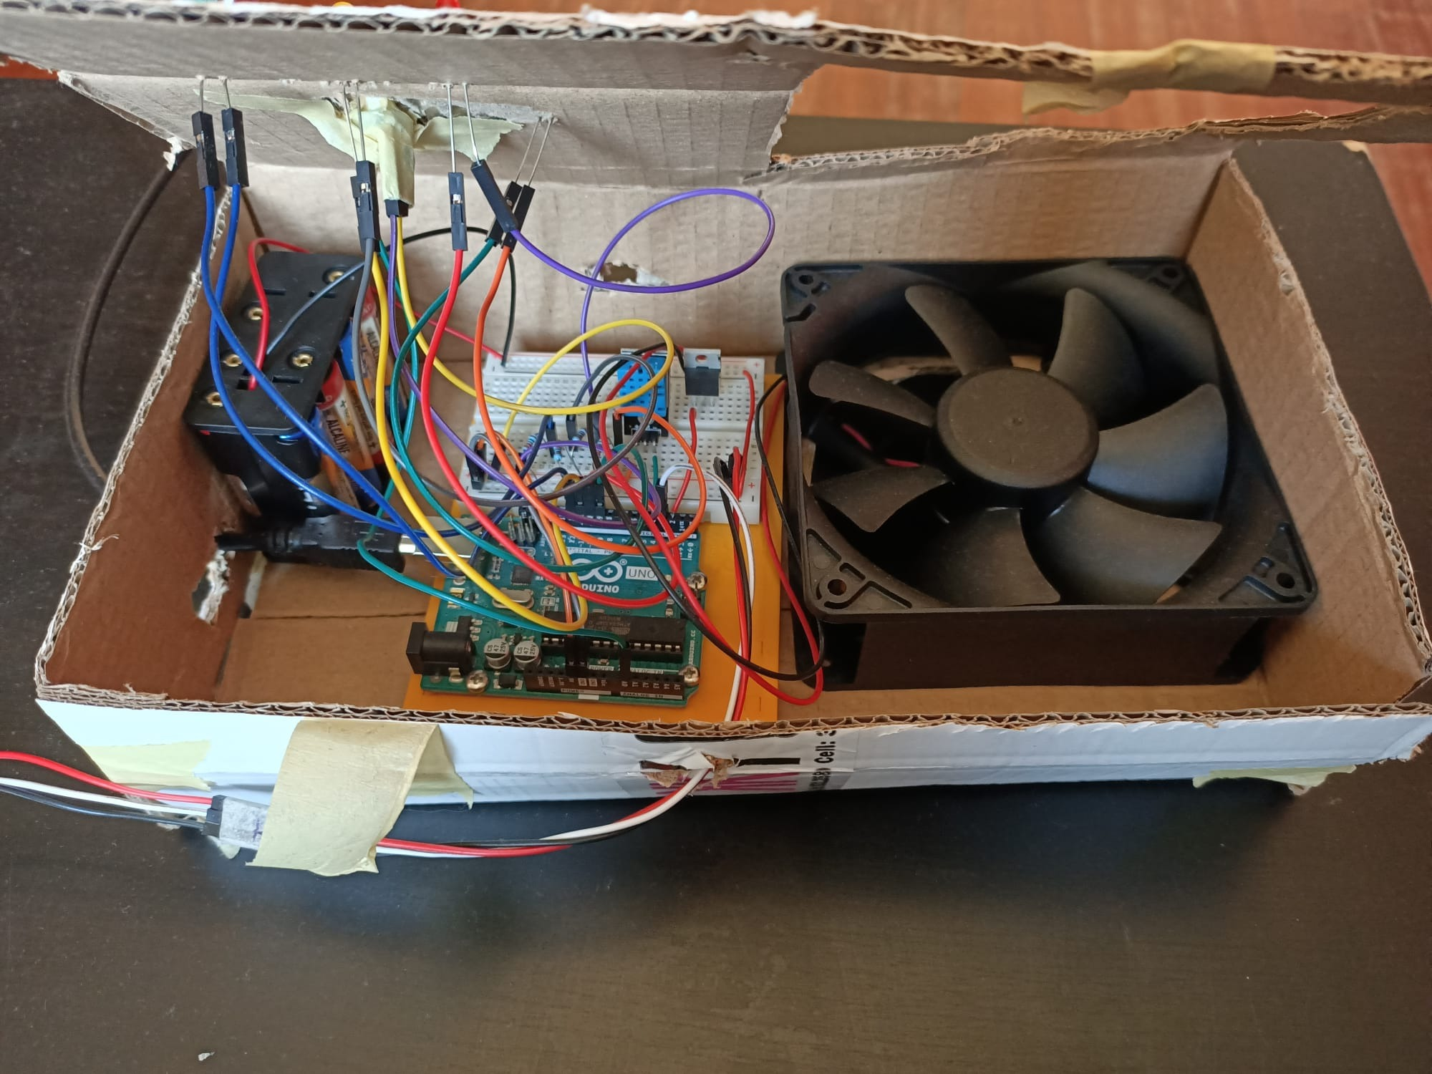
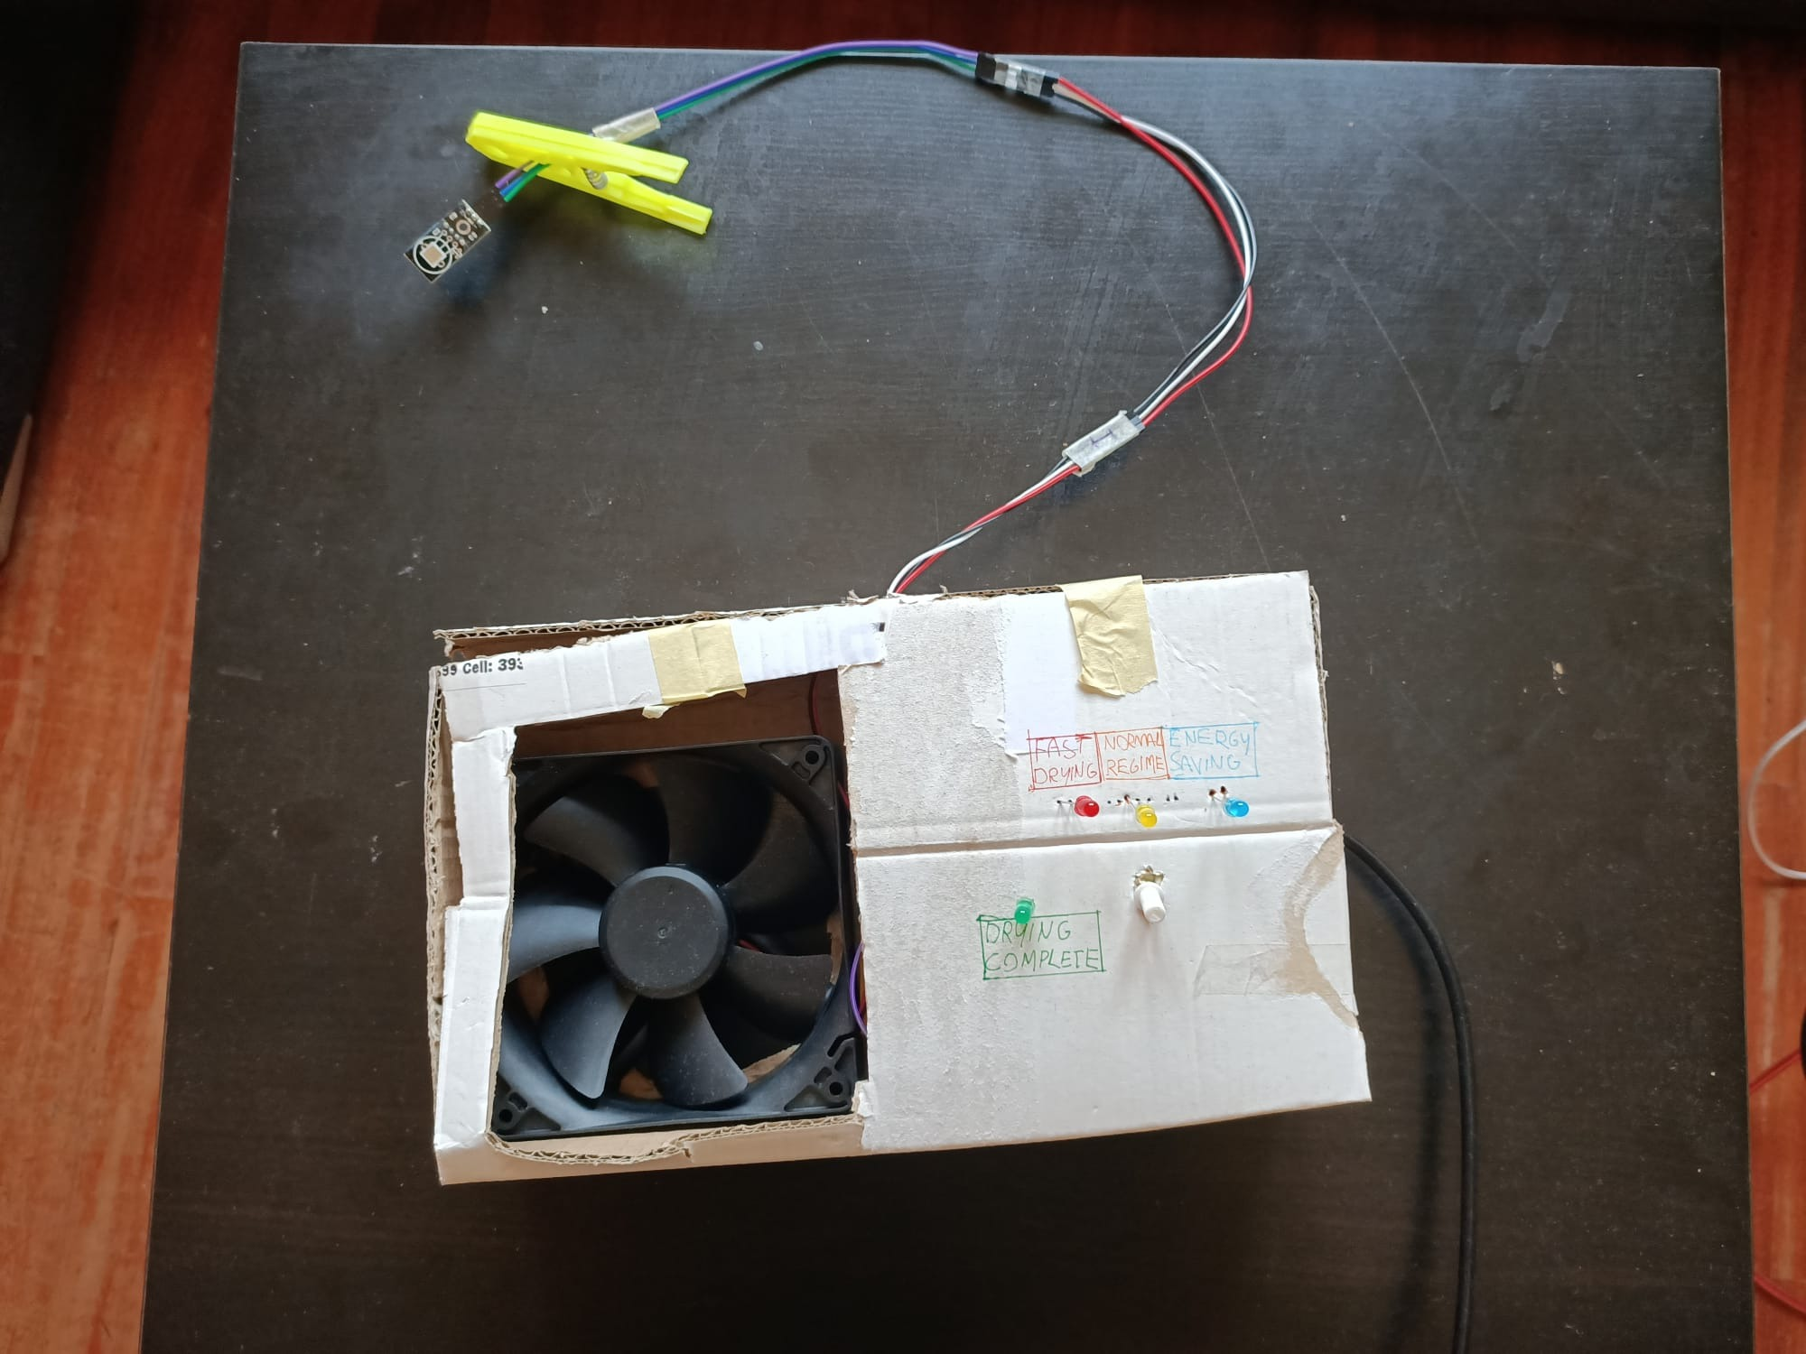
Prototype
Evaluate drying
Humidity sensor
Drying
component
Fan
Humidity sensor DHT11
Sunon MEC0381V1-A99 fan
Prototype photo

Slide 8
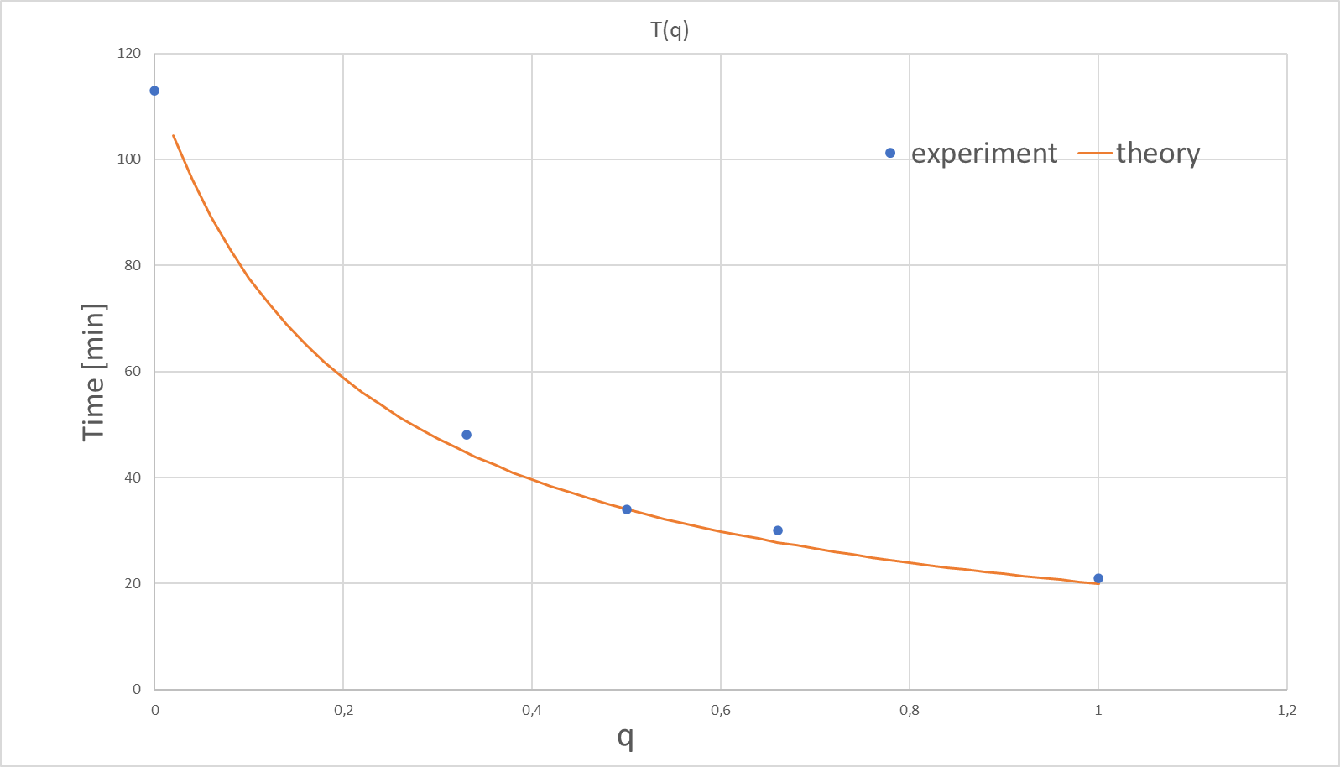
Experiments: physical model
OPERATING REGIME | Fan always off q=0 | 2 min off 1 min on q=0,33 | 1 min off 1 min on q=0,5 | 2 min off 2 min on q=0,5 | 3 min off 3 min on q=0,5 | 2 min off 1 min on q=0,66 | Fan always on q=1
TIME | 113 min | 48 min | 33 min | 38 min | 32 min | 30 min | 21 min
Comparison between experimental and theoretical results

Slide 9
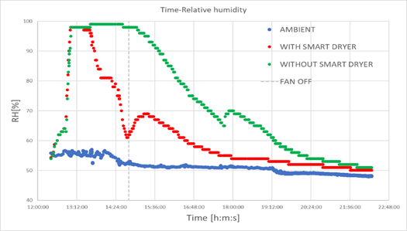
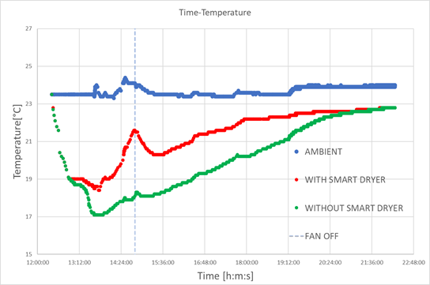
Experiment: real application
Humidity and temperature over time in the final test of the system

Slide 10
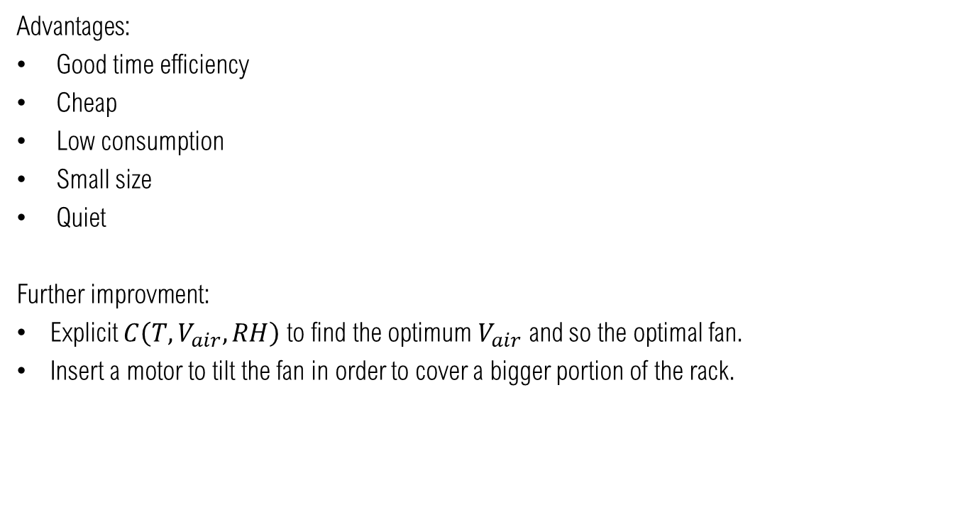
Conclusion
Advantages:
Good time efficiency
Cheap
Low consumption
Small size
Quiet
Further improvment:
Explicit $C\left(T, V_{air},RH\right)$ to find the optimum $V_{air}$ and so the optimal fan.
Insert a motor to tilt the fan in order to cover a bigger portion of the rack.

Slide 11
Thank you for your attention!

